Slide 1

Secure Authentication & Trusted Data Recording in VANETs
Presented by: Mohamed Hesham, Nour Mohamed,and Mohamed Tamer

Slide 2



Problem Statement
Challenges in Traditional VANETs:
- Vulnerable to Sybil & Impersonation Attacks.
- Centralized Architecture = Single Point of Failure.
- Data Tampering: Accident logs can be altered post-incident.
- Lack of Non-Repudiation (Drivers denying actions).

Slide 3



Proposed Solution: Blockchain
Why Ethereum Smart Contracts?
- Decentralization: Removes trusted third parties.
- Immutability: Impossible to alter accident history.
- Automation: Smart Contract enforces rules automatically.
- Security: Cryptographic signatures ensure data integrity.

Slide 4
Core Objectives
1. Secure Authentication:
- Prevent unauthorized nodes from joining the network.
- Use Role-Based Access Control (RBAC).
2. Trusted Data Recording:
- Create a tamper-proof log of traffic incidents.
- Store forensic evidence (hashes) on-chain.

Slide 5
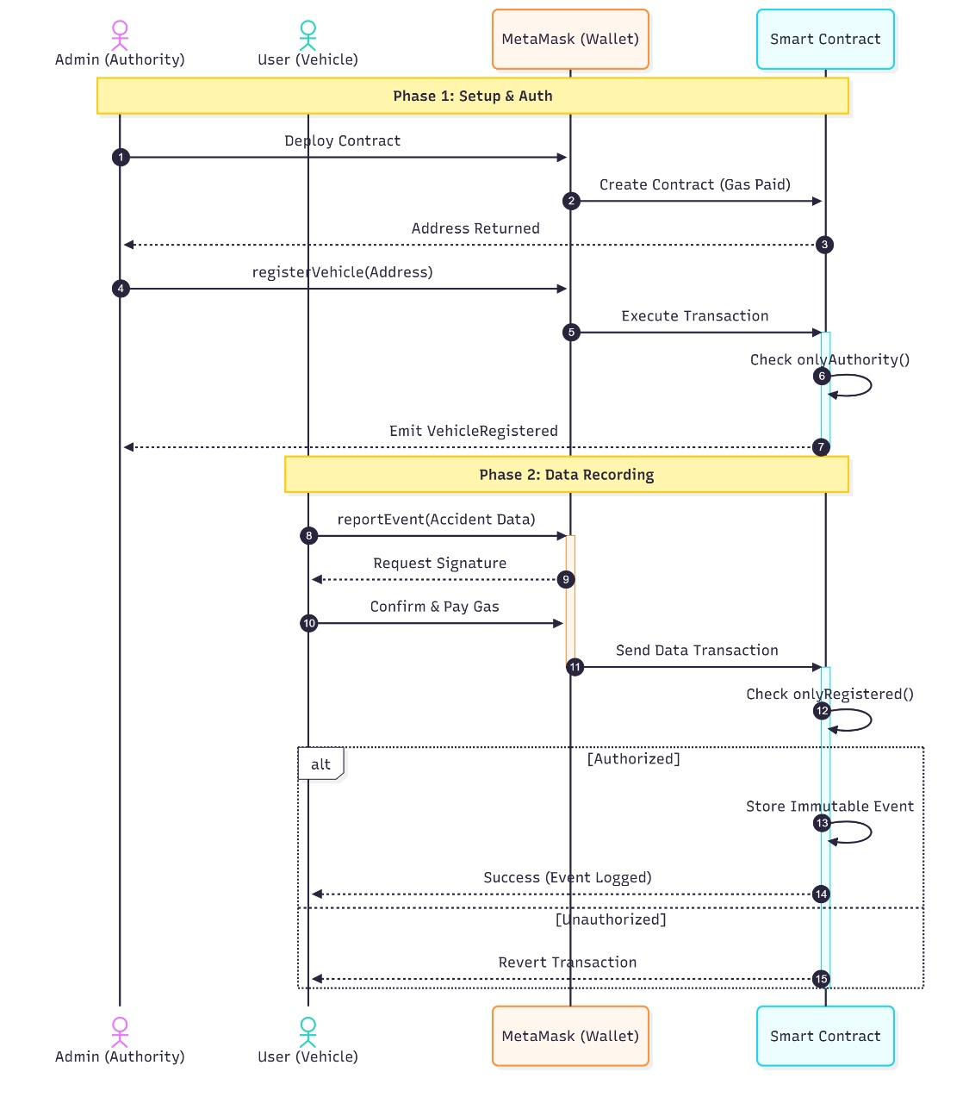
System Model & Entities
Key Participants:
- Traffic Authority (Admin): Deploys contract, registers vehicles.
- Vehicle Node (User): Authenticated driver reporting events.
- Smart Contract: The logic engine on Ethereum EVM.

Slide 6
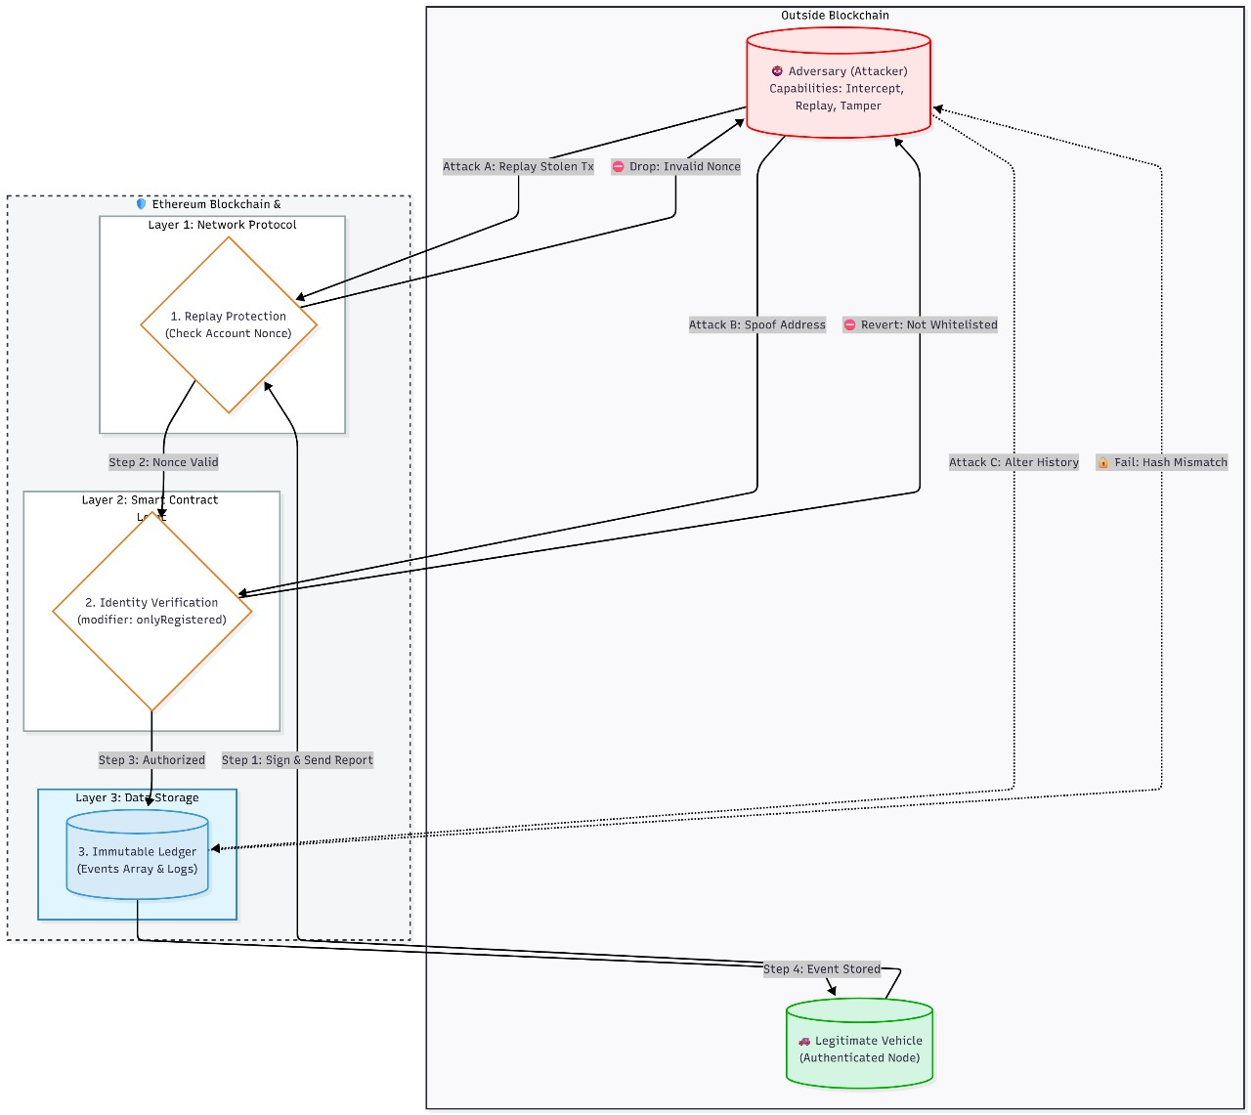
Threat Model & Security
Mitigated Attacks:
1. Impersonation: Blocked by 'onlyRegistered' modifier.
2. Data Tampering: Blocked by Blockchain Immutability.
3. Replay Attacks: Blocked by Ethereum Nonce mechanism.

Slide 7




Implementation Tools
Development Environment:
- Solidity (v0.8.0): Smart Contract Logic.
- Remix IDE: Compilation and Deployment.
- Ganache: Local Blockchain Simulation (10 Accounts).
- MetaMask: Wallet for signing transactions.

Slide 8
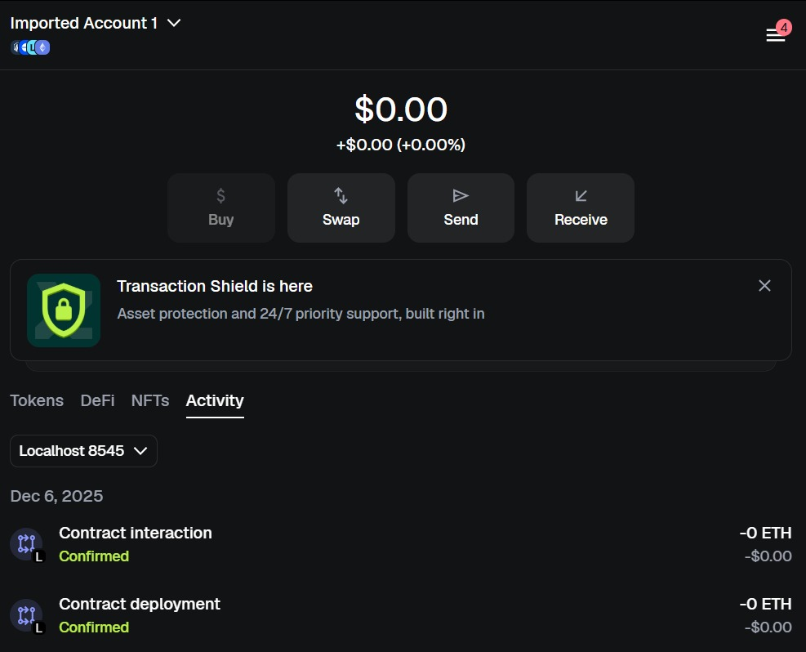
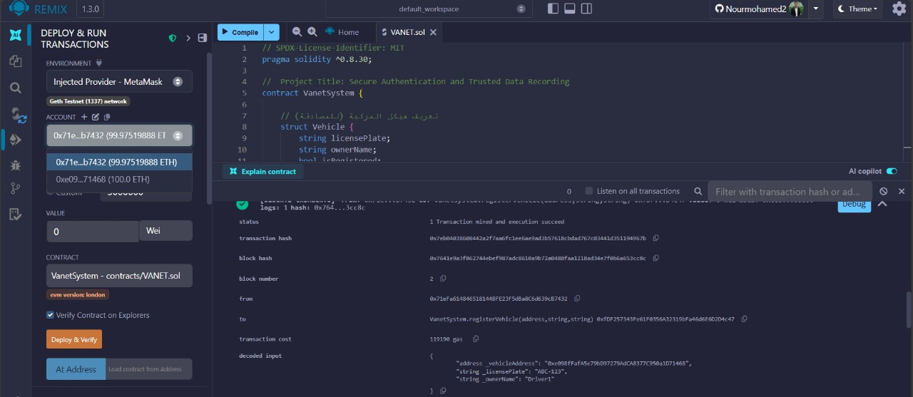
Result 1: Secure Authentication
Scenario: Authority registers a new vehicle.
- Function: registerVehicle()
- Outcome: Vehicle added to whitelist. Event emitted.

Slide 9
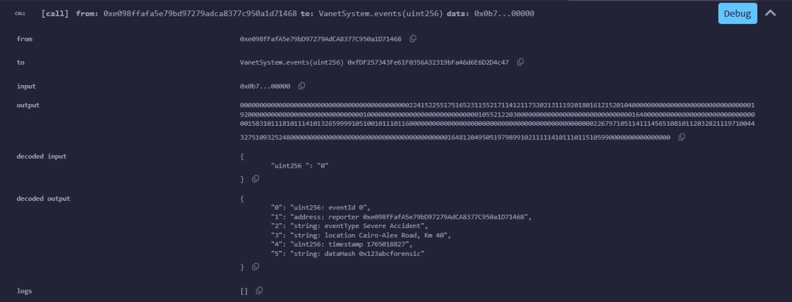
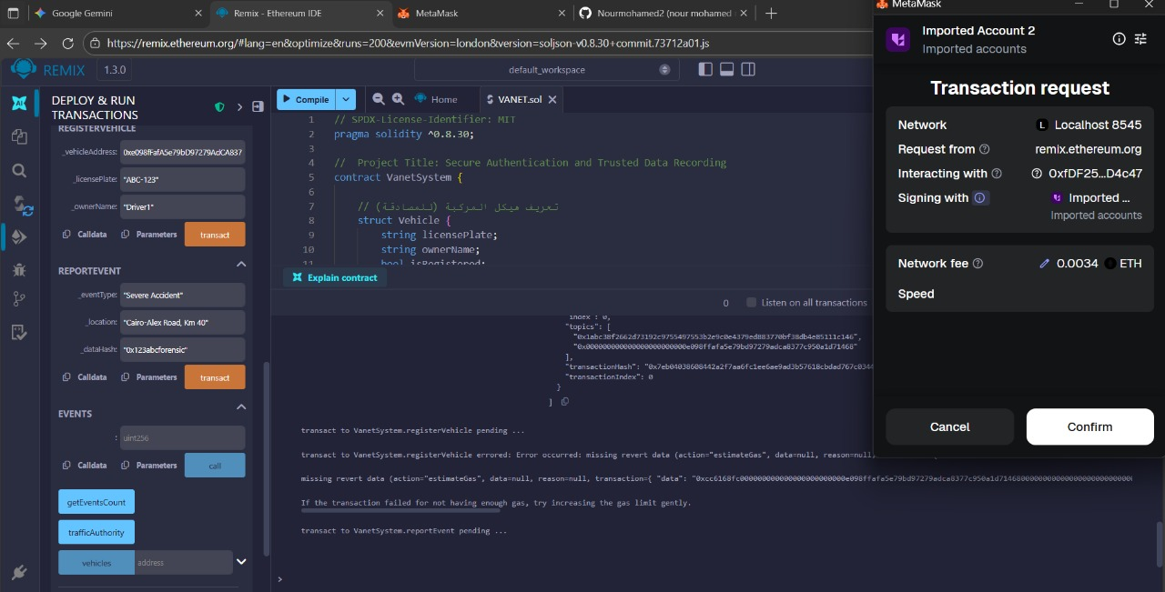
Result 2: Trusted Data Recording
Scenario: Driver reports a 'Severe Accident'.
- Function: reportEvent()
- Data Stored: Location, Timestamp, Forensic Hash.

Slide 10

Performance: Gas Consumption
Cost Analysis (in Gas Units):
- Deployment: ~1,120,866 (One-time setup).
- Authentication: ~119,190 (Efficient O(1) complexity).
- Event Reporting: ~167,969 (Justified by security).
Conclusion: The system is economically viable for critical safety applications.

Slide 11
Future Work
1. Scalability: Migrate to Layer-2 (Polygon/Arbitrum).
2. Privacy: Implement ZK-SNARKs for anonymous authentication.
3. Consensus: Move to Proof-of-Authority (PoA) for faster blocks.
4. Hardware: Test with physical Raspberry Pi OBUs.

Slide 12
Conclusion
- We successfully developed a decentralized VANET framework.
- 'VanetSystem' contract ensures Authentication & Integrity.
- Vulnerabilities (Spoofing, Tampering) are effectively mitigated.
- The system shifts trust from Central Authorities to Code.
Thank You. Questions?

